Slide 1
“CONQUERING THE FIELDS OF Test Maintenance”
Rich Evans and Sonal Pandey
Applications Analysts
Lancaster General Health/Penn Medicine

Slide 2






Lancaster General Health/Penn Medicine
BEDS: 689
Inpatient Discharges: 35,282
EMERGENCY Visits: 116,500
Ambulatory Visits: 989,000
Employees: MORE THAN 7,600
Physicians: MORE THAN 900

Slide 3
LGH : soFT MODULES
Softlab: 4.0.7.1
Softmic: 4.0.7.1
Softpath: 4.0.4
Softbank: 25.1.0.5.1
Softdonor: 4.5.2.2.6
SOFTAR: 4.0.7.1.4
softID
SOFTREPORTS
SOFTSECurity
sOFTMEDIA

Slide 4
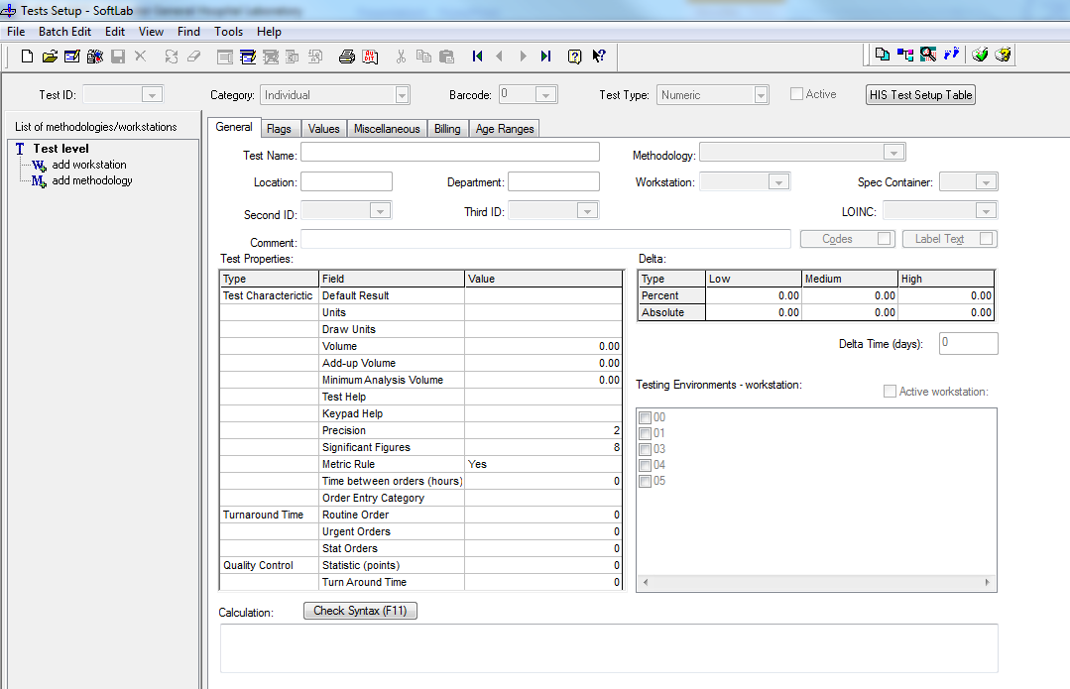
Test Maintenance- General Tab

Slide 5
Test Maintenance- General Tab
Test ID- unique ID to be displayed in Order Entry, Result Entry, and at the Interface Level
Category- Defines whether the test is an individual test or a group test
Barcode- If using barcode scanners to order tests, enter a unique barcode number to identify this test
Test Type- Alphanumeric, Numeric, or Coded
Active- If selected, this test is currently active
HIS Test Setup Table- Bridges to the HIS Test Table to enter information for the HIS about this test
Notes:
This field should not utilize any special characters (+, *, etc.) as the first character in the test ID as it can interfere with result calculations. At Lancaster General we do not utilize any special characters in the test ID. The test ID is restricted to 5 characters in length.
In our scenario the Potassium test is an individual test because there is only one component. If we were utilizing the BMP which contains the Potassium the category would be set to group.
This option is not utilized at Lancaster General. If not using this option, the field should be defaulted to 0
Alphanumeric- The result of this test is alphanumeric (for example, urine color). SoftMic, SoftBank, and Reference Lab tests are always setup as alphanumeric test types. Numeric- The result is numeric (for example, potassium). Coded- Sends a code (for example, a SNOMED code for a specific bacteria) as a result through an ELR (Electronic Lab Reporting) interface to a PHI (Public Health Information) system. This option is not used at Lancaster General.

Slide 6
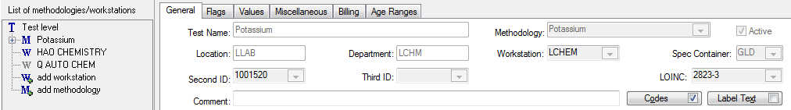
Test Maintenance- Individual Test
Test Name- name of the test
Methodology- name for a group of workstations that perform the test on identical instrumentation that also use the same reference ranges and have the same test properties
Location- location of the testing department and workstation
Department- area within a Location that contains testing stations where the specimen is located
Workstation- where test is performed
Notes:
This test name will appear on all patient result reports.
We have three sites that perform potassium testing. Lancaster General and Women and Babies have the same instrument and therefore we utilize a methodology. The benefit of using a methodology is that you can make changes to both workstations with only one change. Our Heart Group laboratory utilizes a different instrument and that is why we cannot include them under our workstation methodology.
Location- The location field corresponds to the environments that you have setup in your system. For our system we have LLAB (Lancaster General), WLAB (Women and Babies), and CLAB (Heart Group Lab).
Department- Select the area within a Location that contains both manual and automated testing stations where the specimen is located.
Workstation- The workstation must be associated with the location and department field codes.

Slide 7
Test Maintenance- Individual Test
Spec Container- specimen collection specimen tube or aliquot specimen tube
Second ID- Used for multiple purposes depending on your system and setup
LOINC- LOINC code required for electronic medical record systems and medical research databases to allow consistent comparisons of test data
Comments- free text comments for this test
Notes:
In our system the second ID is used to match our LIS tests with the tests built in our HIS.
At Lancaster General we utilize this field as a free text comment only, notifying other users of when the test was activated/inactivated and if there is a replacement test.

Slide 8
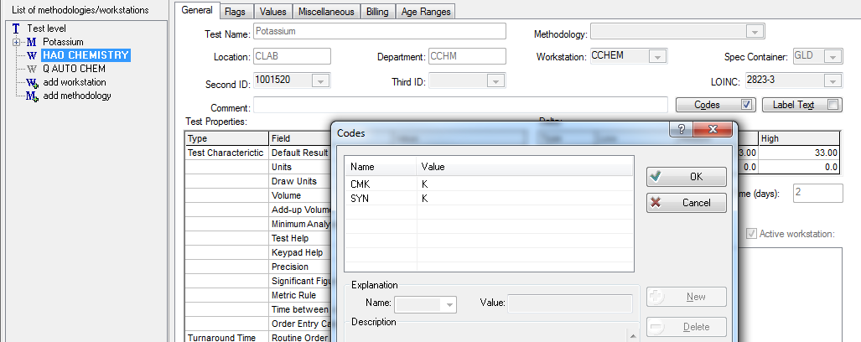
Test Maintenance- Individual Test
Codes- Options include CMK, MSRC, MSC, OH, OKH, QC, RFR, RFRM, SYN, and STN
Notes:
The codes that we use most often at Lancaster General are CMK, OH, RFR, and SYN.
CMK- NEED MORE INFO ON WHAT THIS DOES???
OH- Attaches a canned message to display automatically at Order Entry when the test is ordered.
RFR In the value column denote a reference range to be printed to the RIGHT of the result on the same line. If more than 11 characters are needed for your reference range use the RFRM as this code allows for multiple lines of a reference range.
SYN- Where the value entered is a SYNONYMOUS test name for the defined test, allowing you to search by this synonymous test in Order Entry. For our example, K is medically synonymous for Potassium. A user could search for K or Potassium in Order Entry and return the same test. Multiple synonyms may be defined using a comma as a separator.

Slide 9
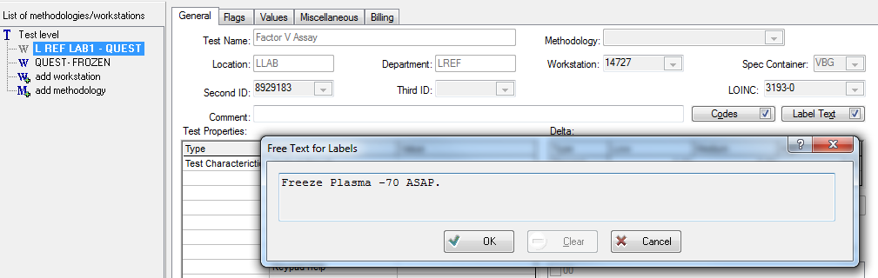
Test Maintenance- Individual Test
Label Text- comment to be printed on the label
Notes:
If this test is a component of a group test, the group test label comment takes precedence over the individual label comment.

Slide 10
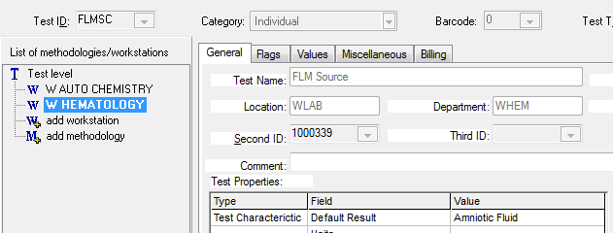
Test Maintenance- Individual Test
Default Result- a pre-defined result for the test
Notes:
In this scenario our Fetal Lung Maturity specimen source is always Amniotic Fluid. Having this set as the default result saves the end user from entering an expected value every time the test is resulted.

Slide 11
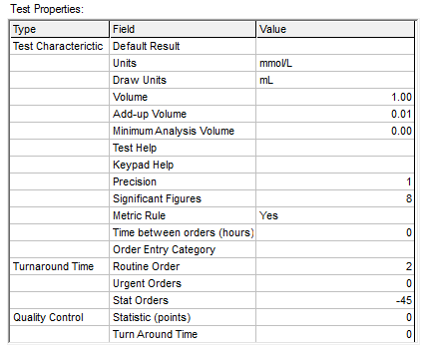
Test Maintenance- Individual Test
Units- units in which the results are expressed for this test that will display with reference result ranges for lab tests only
Draw Units- unit designation
Volume- minimum volume of samples accepted by the department/workstation where testing is performed
Notes:
In our scenario our Potassium results have a unit of mmol/L
Volume- This field is very important as it is used to calculate the number of labels required for collection and aliquot tubes. You can generate extra labels by manipulating this volume in Specimen Tube Types setup.

Slide 12
Test Maintenance- Individual Test
Add-up Volume- minimum volume used to set up and perform this test
Keypad Help- keypad code which can be used for manual resulting purposes
Notes:
Add-up volume: During Order Entry, this volume and the Test volume are used to calculate the number of labels to print.
Keypad Help- This is helpful for when only certain results will be obtained and the result entry is manual. At Lancaster General we use keypads for consistency among resulting

Slide 13
Test Maintenance- Individual Test
Metric Rule- This parameter determines the type of rounding rule that will be used
If this check box is selected, the Metric Rule is applied. This rule specifies that values of 4 or less are rounded down and values of 6 or more are rounded up
If not checked, values of 5 or more are rounded up and values of 4 or less are rounded down

Slide 14
Test Maintenance- Individual Test
Time between orders (hours)- minimum number of hours to wait before ordering this test again for the same patient, either from the HIS or the LIS system.
OE Category- one alphanumeric character to denote an Order Entry category for test(s). Any tests in the same category cannot be ordered together (the tests are mutually exclusive).
Notes:
The OE category is recommended for use with Micro cultures as a way to determine what can be placed together on one order. The OE Category is a one-letter code and any micro test defined with the same OE Category cannot be placed on the same order.

Slide 15
Test Maintenance- Individual Test
Turnaround Time- positive numeric value in appropriate field to denote hours. A number that is preceded by a minus sign (-) is read by the program as minutes.
Notes:
Any time frame that includes a portion of an hour must be converted to minutes. For example, if one hour and thirty minutes is the limit, then the Turnaround Time would be entered as “-90.”

Slide 16
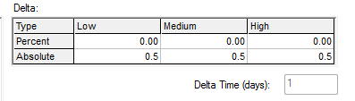
Test Maintenance- Individual Test
Delta- Delta is the difference (deviation) between the current numeric result and the last result for the test. In delta processing, the system sees the current test result/value, finds the range in which the current result lies, and pulls the delta rule that applies to this current range.
Delta Time- number of days the system should include when performing a delta check on the current result. SoftLab searches across stays (hosparam dependent).
Notes:
SoftLab can look within a single stay or across stays, but ALWAYS between the last and current results based on specimen collection time.Enter a numeric value to define the ALLOWED result differences; if a difference exceeds the limit, SoftLab generates a delta warning message. In Results Entry, %D for Percent and aD for Absolute can be designated to display in the Flags column if desired. The flag can also appear on reports. The value is calculated based on your defined values.

Slide 17
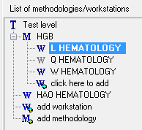
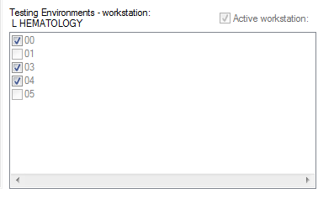
Test Maintenance- Individual Test
Testing Environment- Indicate the physical, or virtual, places/workstations that perform Testing both for themselves, and for any other sites that may send tests to that particular workstation for testing.
Active Workstation- Checking/clearing this box allows you to activate/inactivate the workstation and with its associated test.

Slide 18

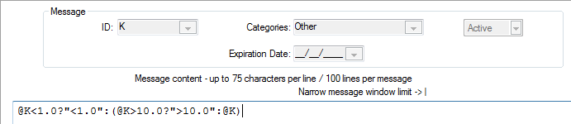
Test Maintenance- Individual Test
Calculation- a formula. Calculations can be entered in three places: individual Test Setup file, Canned Messages Setup file, and the RBS setup file
Check Syntax- Checks the calculation syntax.

Slide 19
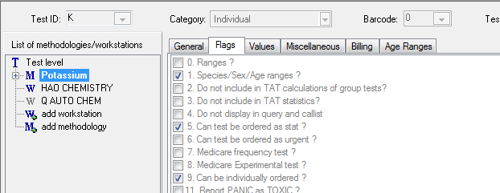
Test Maintenance- flags
Flag 1- Allows species/sex/age consideration and permits the use of expiration dates at later dates

Slide 20
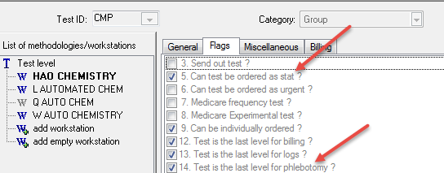
Test Maintenance- flags
Flag 5- allows individual test to be ordered with stat priority
Flag 14- last level for phlebotomy, enables only the group test to print rather than all individual components

Slide 21
Test Maintenance- flags
Flag 9- Must be selected to be available at Order Entry (for viewing, selecting, and ordering). If cleared, the test is not available at Order Entry, but can still be reflexed

Slide 22
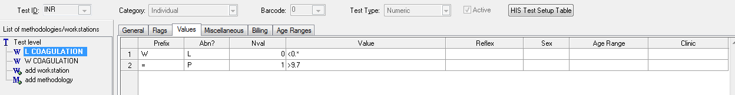
Test Maintenance- Values
Prefix- Select a code to describe the test result range
Abn?- Select a character to define when the AB flag is generated and printed
Nval- Enter a numeric value for each alpha value. Used when calculating the delta check
Notes:
Prefix characters include = (equals), < (less than), [ (less than or equal to), W (wildcard)
ABN? Characters include N (normal), Y (abnormal), P (panic), A (absurd), L (low), H (high) and blank (for numeric tests, defaults to ranges defined in the ranges tab.

Slide 23
Test Maintenance- Values
Value- Define using one of the following:
  < - Upper numeric result value
  [ - Value to which less than or equal to applies

Slide 24
Test Maintenance- Values
Reflex- Enter a code to define the Individual or Group test to be ordered automatically when the test result meets the criteria defined
Sex- Select the sex to which these values apply
Age Range- Enter the age range for the patient to which these values apply
Clinic- Enter a clinic code to reflex designated tests only when the order originates from this clinic

Slide 25
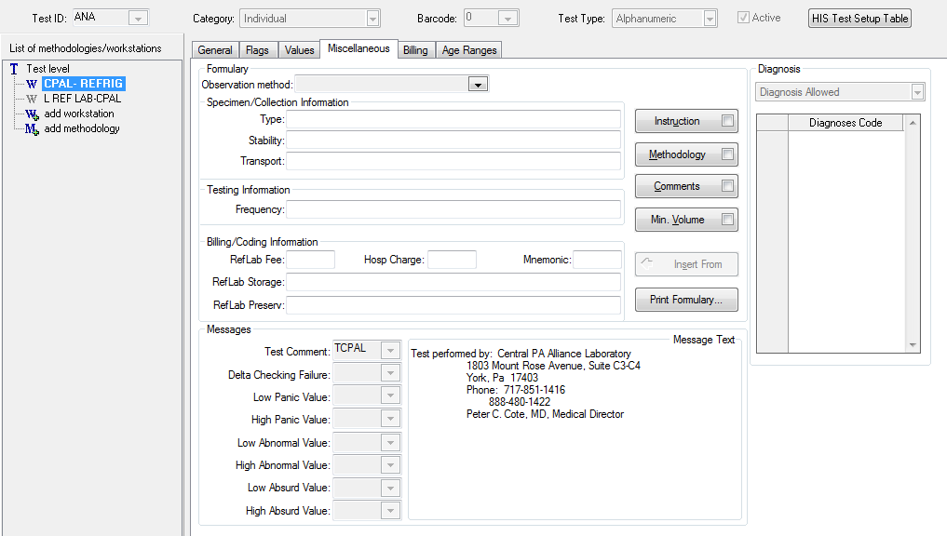
Test Maintenance- Miscellaneous
Test Comment- Displays all T canned messages. All other fields display only R canned messages

Slide 26
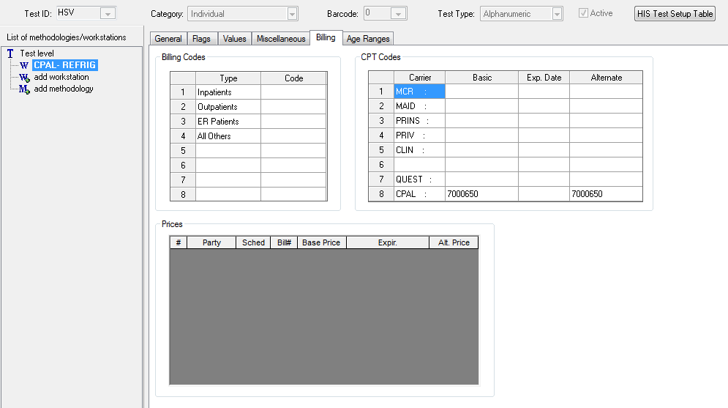
Test Maintenance- Billing
billing information for the individual test to be used in the LIS billing report/file. Enter billing code information as applicable for each patient type
Notes:
Lancaster General does not utilize the billing tab for its intended purpose. The billing tab in test maintenance holds our reference lab test code numbers that are sent and received in the HL7 to/from our reference lab. In this example our HSV test is sent to a reference lab with their test code of 7000650. This is their test code and will allow their instrumentation to run the correct test utilizing the interface messages received from Soft. Order codes from the reference lab are stored in the basic column under the corresponding reference lab “carrier.” When the specimen is resulted at the reference lab we will receive 7000650 as the result component code which will allow auto verification in the LIS and result cam be posted to our HIS. Result component codes are stored in the alternate column under the corresponding reference lab.

Slide 27
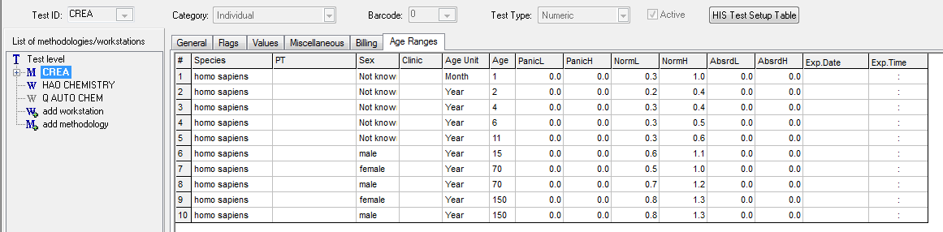
Test Maintenance- Age Ranges
Species- Select the patient’s species.
PT- Select the patient’s type
Sex- Select the Patient’s gender
Clinic- clinic ID code or the code from the field used for grouping clinics (Area, Facility, Group, or Depot).
Age Unit- age unit… day, week, month, year
Age- Age- number corresponding to the patient’s age
Notes:
Clinic ID- You may establish ranges specific to a clinic or group of clinics. If entering a clinic specific range, the system requires that you enter this range on a line before an empty clinic line. SoftLab will see this clinic ID first and match it to the clinic ID in the patient’s demographics.
Age Unit- The reference range is selected at the time of resulting (interface posting or manual resulting). The program stops and makes its selection for reference ranges by converting the patient’s age to days, the age in days is then converted to the reference ranges. As it scrolls through the selections, it will ask the question: Is the Patient Age< or = the range limit? Then, when SoftLab reaches a limit that it can not exceed, it stops. It then uses the last defined limit.

Slide 28
Test Maintenance- Age Ranges
Panic L- low panic value. Set to –1 if normal low is 0
Panic H- high panic value
Normal L- low normal value. If the normal low value is 0, then the panic low and absurd low should contain a value of –1 (this will keep a 0 result from flagging as absurd or panic low)
Normal H- high normal value

Slide 29
Test Maintenance- Age Ranges
Absurd L- low absurd value
Absurd H- high absurd value
Notes:
The absurd values correspond to instrument linearity ranges. If a number is achieved that is outside of the instrument linearity and the absurd flags are checked, the result will flag with a black triangle.

Slide 30
Test Maintenance- Age Ranges
Exp Date/time- Leave this field empty for active reference ranges. To expire a range, enter the last date to use this range. Tests that were ordered prior to editing this field, but were not verified, will assume the new ranges established.
Notes:
Exp Date- WARNING: It is critical to cause reference ranges to expire using this field rather than editing or deleting reference ranges. Single sheet reports print expired ranges under the Reference Range column. Chart reports print expired ranges as a test message (M1).

Slide 31
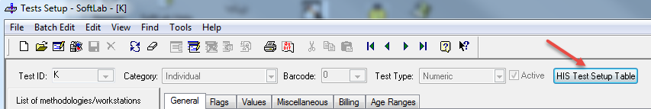
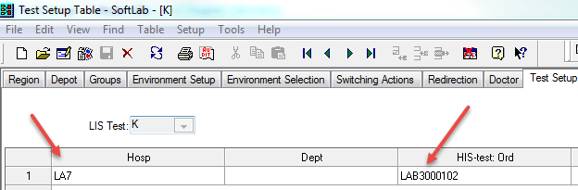
Test maintenance – his test setup table
His test setup table: used to identify tests in lis AND his
Notes:
- Unique identifier used in the Hospital field to identify the lab orders in the interface

Slide 32
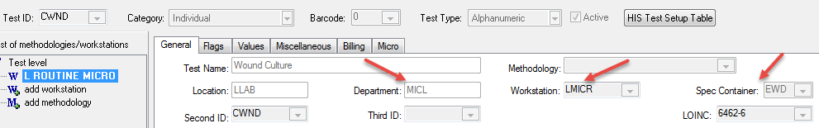
Test maintenance - micro
Department – anything starting with MIC will automatically be routed to Softmic
Workstation – most micro cultures use the same workstation
Spec container - same until recently for ELR interface
Notes:
Location is the same as the one lab test use. LGH only has one location with different sites.
Department – most of Micro uses the same Department, anything starting with the first three letter of MIC will automatically be routed to the SoftMic, unless the test is built on the Lab side.
Workstation - all the cultures are listed under the same workstation
Spec container – Micro used to have mostly all the same specimen containers generically called “Sterile container” until recently for the ELR (Electronic Lab Reporting) to State of PA when it needed to be uniquely identified.

Slide 33
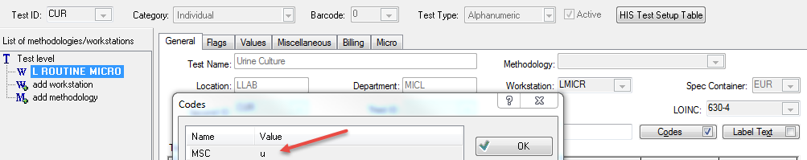
Test maintenance - Micro
MSC code – associates the source category codes to a micro test, only these sources will appear in order entry to pick from
Notes:
MSC code – it helps associate the source category code to a specific culture type, this enables only the list of sources associated with this code to appear as choice of sources in Order entry. For this example for a urine culture order we have the Midstream, Void, Cath, Nephrostomy and Cystoscopic urine associated with this source code so only those ones appear in OE.

Slide 34
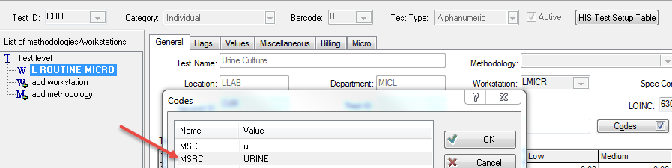
Test maintenance - micro
MSRC CODE – MSRC URINE LINKS THE URINE SOURCE TO THE POS URINALYSIS BASED ON rbs rule, only one source can be used
Notes:
MSRC code – used in Micro only, this code helps associate this source in Micro to the Urine culture order reflexed from a UA order using a RBS rule. Note that only one source can be associated with this MSRC code.

Slide 35

Test maintenance - mICRO
fLAGs – 25 flag will enable the abnormal cultures to not qualify to the call list
Notes:
At LGH we do not

Slide 36
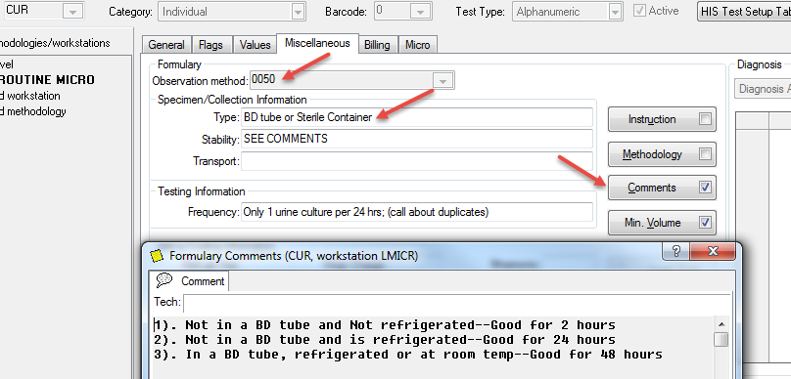
Test maintenance – micro
OBSERVATION CODE – meaningful use & ELR REQUIREMENT TO ASSOCIATE THE METHODOLOGY OF TESTING
Formulary – Transport media and specimen integrity comments can be added
Notes:
Observation method – was added to the test maintenance to add the methodology of test for the ELR interface reporting to the State.
Type field can be used to setup the formulary to indicate the transport media
Comments section can be used to add comments like shown here to communicate the length of time a specimen is good for based on the media used for transportation

Slide 37
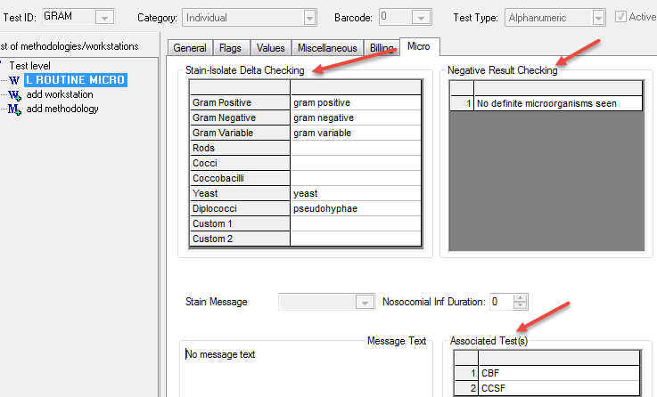
Test maintenance - micro
Stain-isolate delta checking – list of phrases to look for in the gram stain report
Associated tests – tests listed here will be flagged if the gram stain report and the culture report do not match
Negative result checking – used to show the negative phrase that would be used in the culture

Slide 38
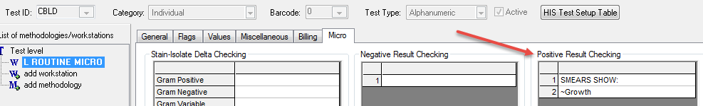
Test maintenance - micro
Positive result checking – used TO FLAG BLOOD CULTURES AS ABNORMAL IN his AFTER THE GRAM STAIN IS READ
Notes:
Positive result checking is used to flag orders like blood culture as abnormal in HIS in situations where the gram stain is read and is positive but the culture has yet to grow out.

Slide 39
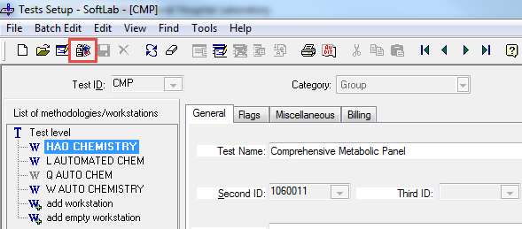
PERFOMANCE ENHANCING TIPS
Copy test (insert new record): create new test using an already existing one

Slide 40
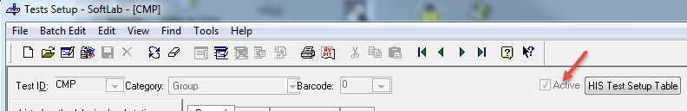
PERFOMANCE ENHANCING TIPS
Inactivating group vs. individual test
Group : use “ACTIVE” FIELD
INDIVIDUAL :
CHANGE TUBE TYPE TO NULL
UNCHECK FLAG 9 (IF CHECKED)
CHECK FLAGS 13A, 15, 22, 25, 34
ENTER DEFAULT RESULT “.”

Slide 41
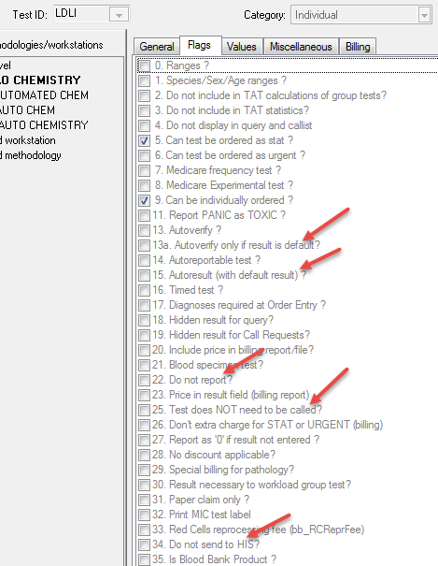
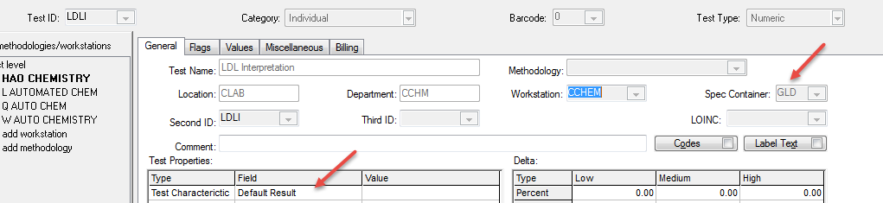
Performance enhancing tips
Inactivated flags
Specimen container inactivation, default result

Slide 42

Questions?

Slide 43
“CONQUERING THE FIELDS OF Test Maintenance”
Rich Evans and Sonal Pandey
Applications Analysts
Lancaster General Health/Penn Medicine

